Slide 1
Persistent Data
Cowboys and Bullet Points

Slide 2




Question #1
What should you save?

Slide 3

Question #2
Where can you save it to?

Slide 4
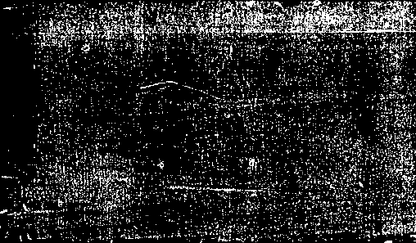


Answers
Where can you save it to?
Local System Files
PlayerPrefs.SetFloat(“MasterVolume”, _slider.value);
_slider.value = PlayerPrefs.GetFloat(“MasterVolume”, defaultValue);
Local Application Files
System.IO.File.WriteAllText("MySaveData.txt", "Hello World!");
string myText = System.IO.File.ReadAllText("MySaveData.txt");
Cloud-based, Unity-Specific
Using Unity.RemoteConfig;
Cloud-based server/db, custom or third-party (e.g. Playfab)

Slide 5
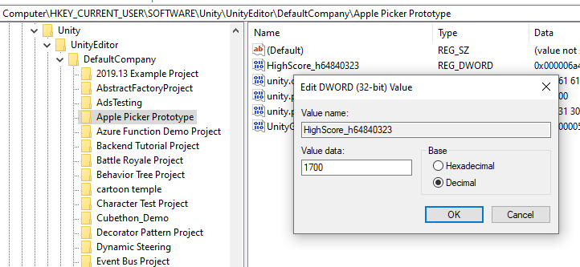
1. System Files
Example: Unity’s PlayerPrefs reads/writes the Windows Registry
VolumeControl.cs from GS1 Terrible Tweeters

Slide 6
1. System Files
Example: Unity’s PlayerPrefs reads/writes Windows Registry
VolumeControl.cs from GS1 Terrible Tweeters
Pro: Super-easy to use
Con: Limited to Ints, Floats, and Strings
Con: Not easily backed up or transferred
Con: Registry-bloat / possible memory limitations
Con: Hackable

Slide 7
1. System Files
Example: Unity’s PlayerPrefs reads/writes Windows Registry
VolumeControl.cs from GS1 Terrible Tweeters
Note: if you can store strings, you can store anything…
json for example: Weimann, Saving & Loading Complex Data in Unity3D

Slide 8
2. Local Files
Examples: flat files in any format
Plain text: System.IO.File.WriteAllText("MySaveData.txt", "Hello World!");
Next slide: read/write objects using json
Local database: using e.g. SimpleSQL from Unity Asset Store

Slide 9
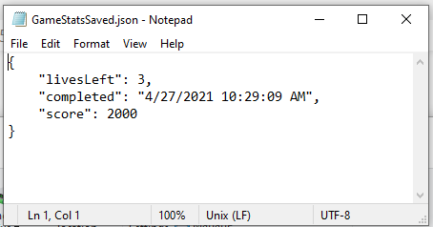
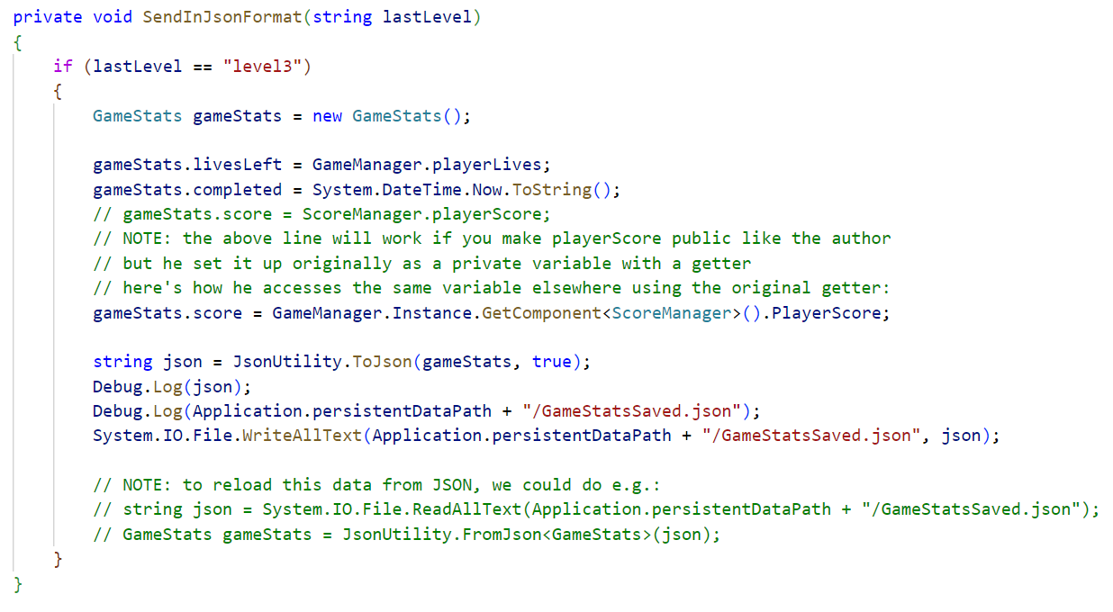
2. Local Files

Slide 10
2. Local Files
Pro: Fairly straight forward
Pro: Easily backed up, transferred or shared
Pro: Store any data type without the tom-foolery of stuffing the Registry with strings of json
Con: Even more hackable
But we have options here…

Slide 11

2. Local Files
Securing Local Files (Obfuscation)
Write binary files using
C# [Serializable] and
System.Runtime.Serialization.Formatters.Binary
Example 1: Brackeys, Save & Load System in Unity
Example 2: Game Dev Guide, How to Build a Save System in Unity

Slide 12

2. Local Files
Securing Local Files (Salted Checksums)
{ "name"="john", "score"="1234", "protection"="043DA33C" }
“protection” is a hashcode (one-way encryption) of “john1234” (+ salt)
It will not match “john9999” (+ salt)
When you load the data, you compute what the protection should be and compare
Pro? Con? Data is readable by humans.

Slide 13
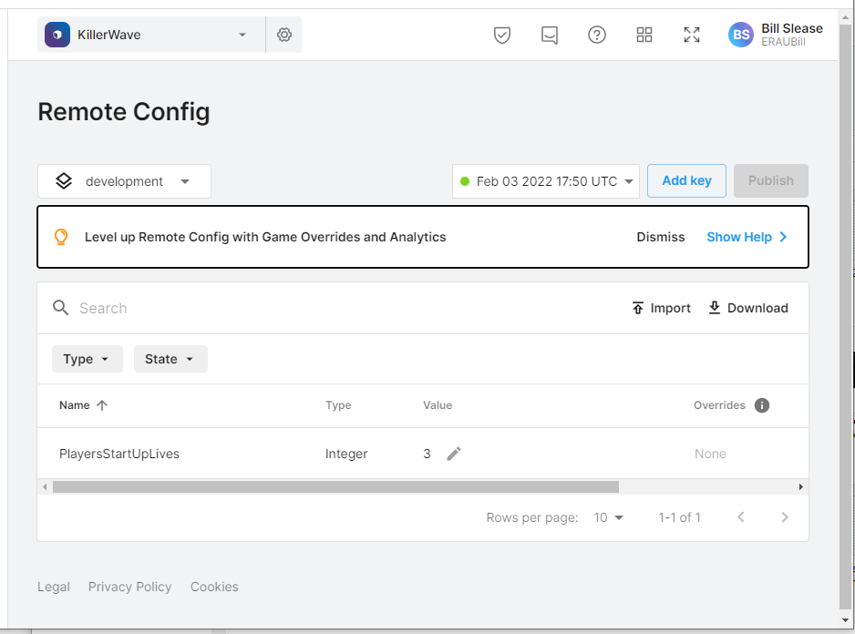
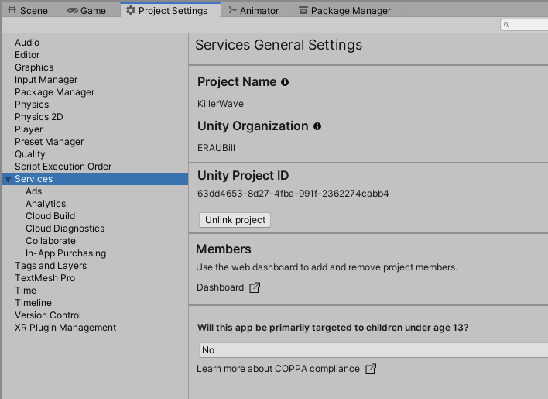
3. Cloud-based, Unity-Specific
Example: Unity Remote Config

Slide 14
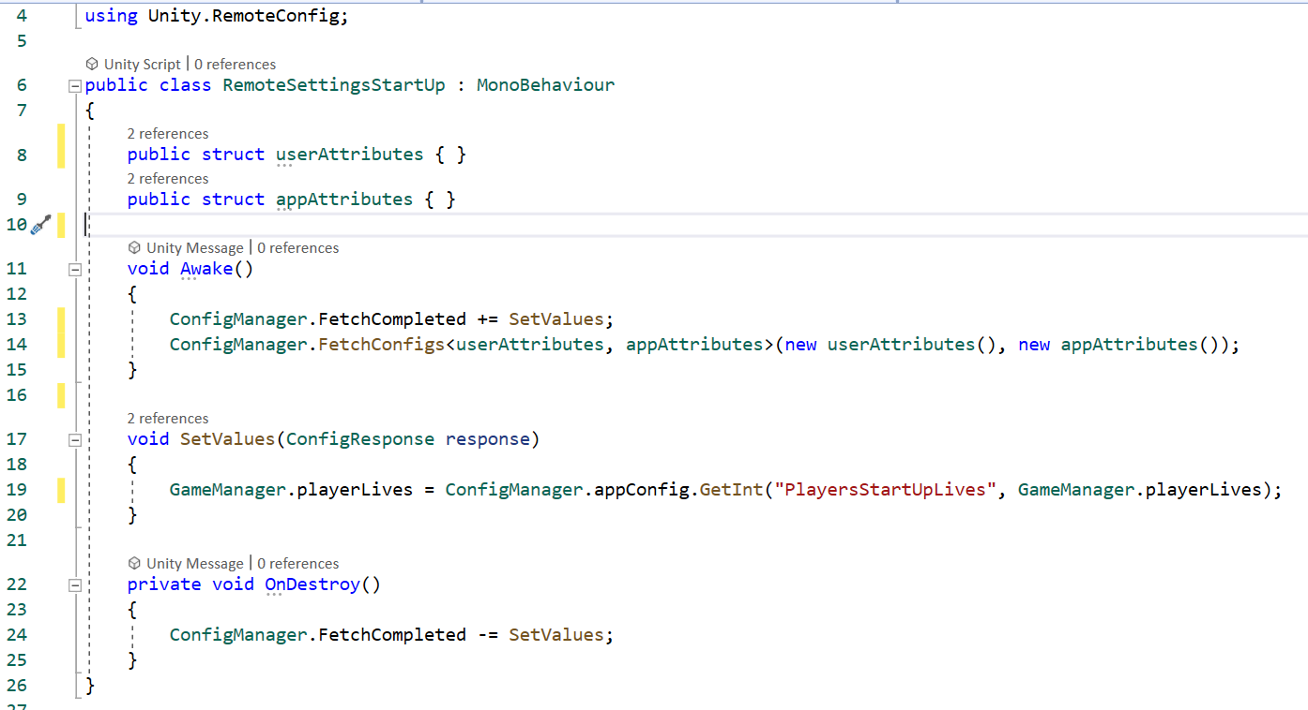
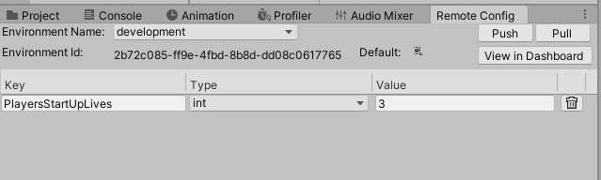
3. Cloud-based, Unity-Specific
Example: Unity Remote Config

Slide 15
3. Cloud-based, Unity-specific
Pro: More Secure
Pro: Editable by non-programmer (LiveOps)
Con?: Remote Config is read-only from client
Con?: Remote Analytics are write-only from client
Con: More complicated set up
Con: Dependent on remote service uptime/accessibility
Con: Updates to API and dashboard can break existing titles

Slide 16
4. Cloud-based, Custom or Third-Party
Examples: Azure Playfab, Roll your own (Sim 421)
Pro: Readable and Writable from client
Pro: Server-side scripting to detect and prevent exploits
Pro: Can be more stable and scalable than Unity’s
Pro?: As secure as you make it
Pro: Most flexibility in data model (what is saved and how)
Con: The most complicated set up

Slide 17

Summary
Where can you save it to?
Local System Files
PlayerPrefs.SetFloat(“MasterVolume”, _slider.value);
_slider.value = PlayerPrefs.GetFloat(“MasterVolume”, defaultValue);
Local Application Files
System.IO.File.WriteAllText("MySaveData.txt", "Hello World!");
string myText = System.IO.File.ReadAllText("MySaveData.txt");
Cloud-based, Unity-Specific
Using Unity.RemoteConfig;
Cloud-based server/db, custom or third-party (e.g. Playfab)

